Slide 1
Python Part I
Intro: Motivation + Design Philosophies
The Interpreter & Dynamic Typing
Basic Syntax & Usage:
Basic Variable Types: Numeric, Strings, Lists
Conditions & Loops
Functions

Slide 2
Python – Intro
Python is a general-purpose high-level language
It supports multiple programming paradigms & concepts
Imperative Programming
Functional Programming
Object Oriented Programming
Dynamic Typing – הטיפוס לא מוגדר ולמעשה יכול להשתנות במהלך הריצה
Scripting Language
Interpreted Code
Sources: tutorial on python.org , dive into Python book
Notes:
https://en.wikipedia.org/wiki/Imperative_programming

Slide 3
Why Python?
Cross Platform – runs almost anywhere
Ideal for scripting and rapid application development
Designed to be easy to learn and code
Clean, clear and simple syntax
Much shorter code than C/C++ and Java
Much easier to read, write & understand python code then other scripting languages
Has an extensive standard library
Everything is open source
Very popular in the industry

Slide 4
Design Philosophy
Beautiful is better than ugly.
Explicit is better than implicit.
Simple is better than complex.
Complex is better than complicated.
Flat is better than nested.
Sparse is better than dense.
Readability counts.
Special cases aren't special enough to break the rules.
Although practicality beats purity.
Errors should never pass silently.
Unless explicitly silenced.
In the face of ambiguity, refuse the temptation to guess.
There should be one – and preferably only one obvious way to do it.
Although that way may not be obvious at first unless you're Dutch.
Now is better than never.
Although never is often better than *right* now.
If the implementation is hard to explain, it's a bad idea.
If the implementation is easy to explain, it may be a good idea.
Namespaces are one honking great idea -- let's do more of those!

Slide 5
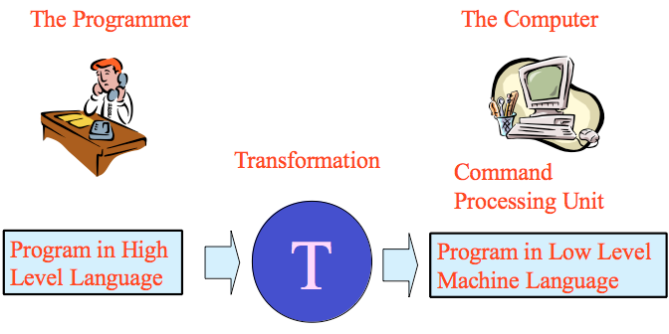
Compiled vs. Interpreted Code
The CPU only understands machine code
A high-level language code should be transformed to machine code
There are two ways to do this transformation

Slide 6
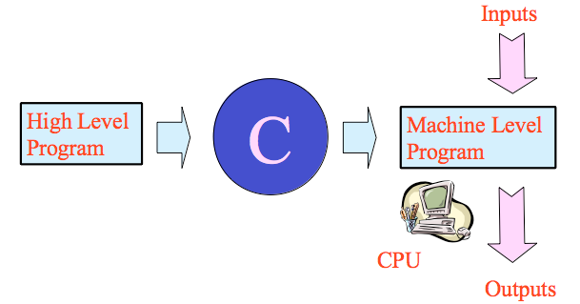
The Compiler
The Compiler translates the complete program to machine code
Compiled Languages examples?
C/C++, Java*, Fortran, Haskell, Pascal, Ruby, many others
Notes:
* More precisely, Java is compiled to “bytecode”, which is then interpreted.

Slide 7
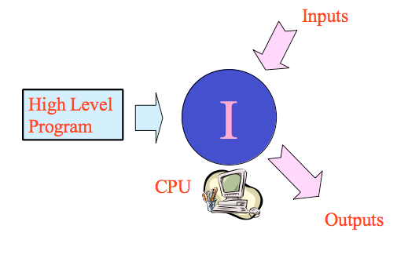
The Interpreter
The interpreter interprets and executes the program line by line.
Scripting languages use interpreters. Examples?
Perl, PHP, JavaScript & Python

Slide 8
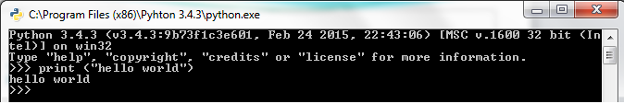
The Python Interpreter
Download & install from https://www.python.org/
All the necessary documentation is also there
Python 3.4.1 is already installed on lab computers
Invoke the python interpreter from the start menu or the installation folder (usually c:\Python34)

Slide 9
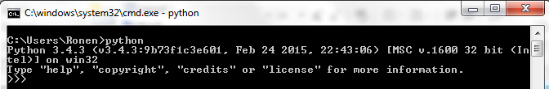
The Python Interpreter
You can also run it from the DOS command line
To run the python command from anywhere in the file system, you need to set the %PATH% environment variable (during or after the installation)
Let’s do some simple calculations

Slide 10
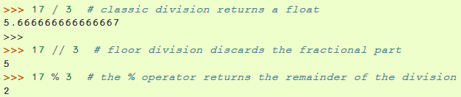

Numerical & Logical Operators
Common logical operators and keywords:
and, or, not, True, False
==, !=, <=, >=
A and B and C: If B is false, C is not evaluated

Slide 11
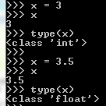
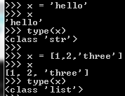
Dynamic Typing
Python supports dynamic typing – no need to declare variable types, and they can also change in runtime!

Slide 12
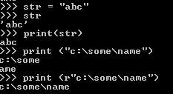
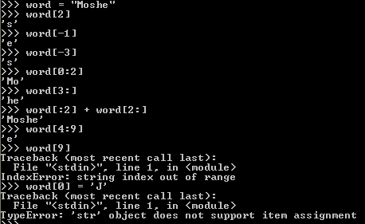
Strings

Slide 13
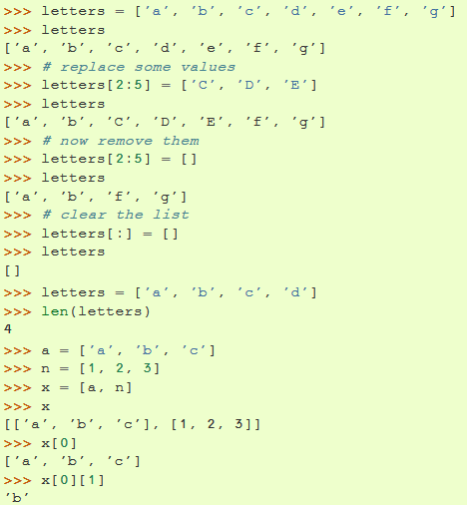
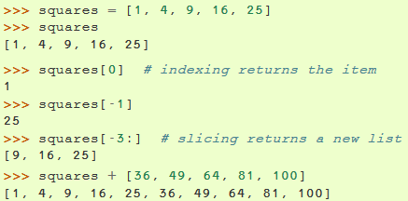
Lists
Notes:
Notice that the last statement in the left example square…creates a new list obj leaving squares unchanged!
Meaning: list_1 + list_2 -----> new_list
While: list_1.extend(list_2) -----> list_1, which will contain list_2 at the end of it without any new list created.
The same goes with the += operator for the previous wanted outcomes…
This is the difference when saying you do an inplace change when using extend(…)

Slide 14

Lists ←→Strings
String → List, the naïve way:
String → List, the smarter way, with split():
List → String: join() does the opposite thing

Slide 15

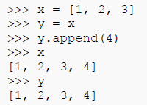

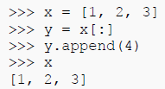
Python Variables & Assignments
Python variables are pointers
Assignments of immutable vs. mutable variables
We can use slicing from start to end to make a copy
vs.
vs.

Slide 16
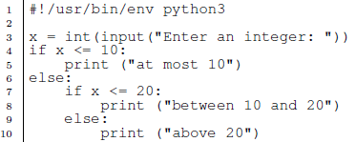
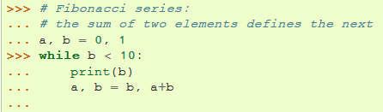
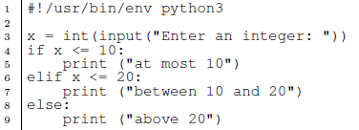
Control Structures
condition & indentation
the elif keyword
while loop
Note the double assignment
Note the empty line. Why?
What would be the output?

Slide 17
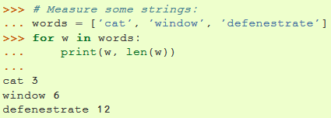
For Loops
For loops iterate over a sequence (list, string)
We don’t mention the start & end point of an iterator
Instead we use the ‘in’ keyword
It brings us the value itself, not the current index

Slide 18
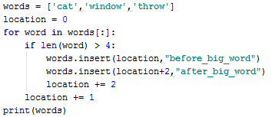
Changing the loop’s sequence
If we want to change the loop’s sequence inside the loop, we should iterate over a copy of the sequence
Again, slicing is helpful here
What will happen if we replace words[:] with words?

Slide 19
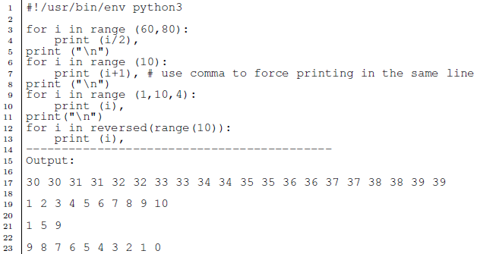
The range() function
The range() function produces a numerical sequence
What about going backwards?
The 3rd parameter is the step value

Slide 20

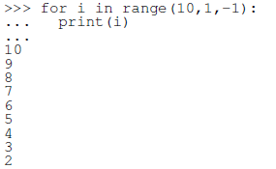
Descending Sequence
If start index > end index the loop is not entered
To force descending we use negative progression

Slide 21
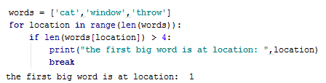


Iterating with range() & len()
With range() & len() we can also iterate over a sequence by using a location index:
range() itself does not return a list, it return an iterable
iterable items are useful for many functions, like list():

Slide 22
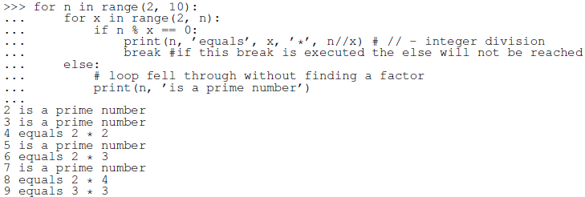
for…else
An else clause following a loop is executed:
When we traverse the entire range (for loop)
When the loop’s condition becomes false (while loop)
In both cases when we did not hit break

Slide 23
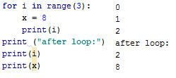

Loop Variables Scope
In Python, variables live outside the loop’s scope
What would be the output of the following code?

Slide 24

Iterating Indexes & Values Together
We can iterate the values using in
We can iterate the indices using range() & len()
And access the values with lst[index]
enumerate brings the indices and values together:

Slide 25
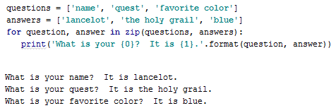
Iterating Multiple Sequences
zip() allows iterating multiple sequences in one loop
It returns an iterator of tuples, where the i-th tuple contains the i-th element from each sequence
Notes:
רץ עד לרשימה הקצרה מביניהם

Slide 26
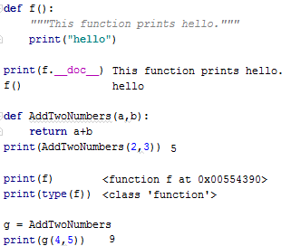
Functions
Functions defined by def
The first line (that starts with “““) is the docstring
Functions can return values (or None === void)
In Python, functions are objects of class function
This allows us to assign function as variables

Slide 27
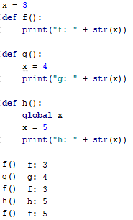
Functions Scoping
Variable lookup is done by the LEGB rule
Local, Enclosing, Global, Built-in
Assignment to variables automatically considered local
Unless the global keyword is used

Slide 28
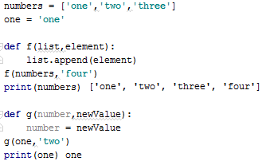
Passing Arguments to Functions
In Python we cannot choose between by value or by reference
Arguments are passed by object-reference
Mutable variables (like lists): passed by reference
Immutable variables (numbers, strings): passed by value

Slide 29
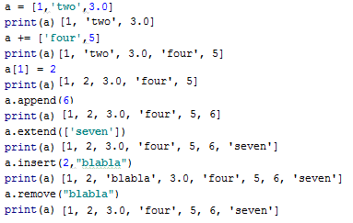
Lists Manipulations
Lists can contain different data types
We can concatenate lists using +=
We can access & change the lists items by index
Class list also has useful built-in functions: append, extend, insert, remove
Will a += ‘8’ work?,
What will a.append([8]) do?
Notes:
Implicit casting : list(‘123456’) = [‘1’, ’2’, ’3’, ’4’, ’5’]
a = [700, 800, 900]
a+=‘8’ ----> a = [700, 800, 900, ‘1’, ’2’, ’3’, ’4’, ’5’]
complexity inefficient new memory is assigned to a and contents is copied accordingly, should be used with extend(…) meaning inplace operation is done
a.append([‘8’]) ----> a = [700, 800, 900, [‘8’]]

Slide 30
More Useful List Functions
remove(x) raises an exception if x isn’t available
so does index(x)
count(x) counts the appearances of x
and can also tell us if x is in the list
Use insert(i,x) to insert item x at index i
What does a.insert(len(a),x) do?
What other way can you do the same? - a.append(x)
Other (obvious) functions: clear, sort, reverse, copy
sorted returns a sorted copy of the list
Useful when we want to iterate over a sorted copy without changing the original list

Slide 31
Exercises
Define a function overlapping() that takes two lists and returns a list of all the members they have in common. Do the exercise twice:
With two nested for loops
With a single loop using the ‘in’ operator inside the loop
Define a function is_palindrome() that recognizes palindromes (words that look the same backwards).
For example, is_palindrome("radar") should return True.
Try to use only one index in your loop.

Slide 32
Exercises (2)
Write a program which will find all such numbers which are divisible by 7 but are not a multiple of 5, between 2000 and 3200 (both included). The numbers obtained should be printed in a comma-separated sequence on a single line (hint: use the join function).
Write a function encrypt() that gets a string and returns a translated string by doubling every consonant (and not a vowel). E.g, "this is so fun" should be translated to "tthhiss iss sso ffunn".
Write the opposite function decrpyt()

Slide 33
Exercises (3)
Write a recursive function that takes a number and prints the “99 bottles” song with the following format:
99 bottles of beer on the wall, 99 bottles of beer. Take one down, pass it around, 98 bottles of beer on the wall.
Write a function that gets a list of strings and returns the longest string. The list can also contain inner lists of strings, so you need to look inside those lists as well.
Hint: Use the isinstance() function.

